Slide 1
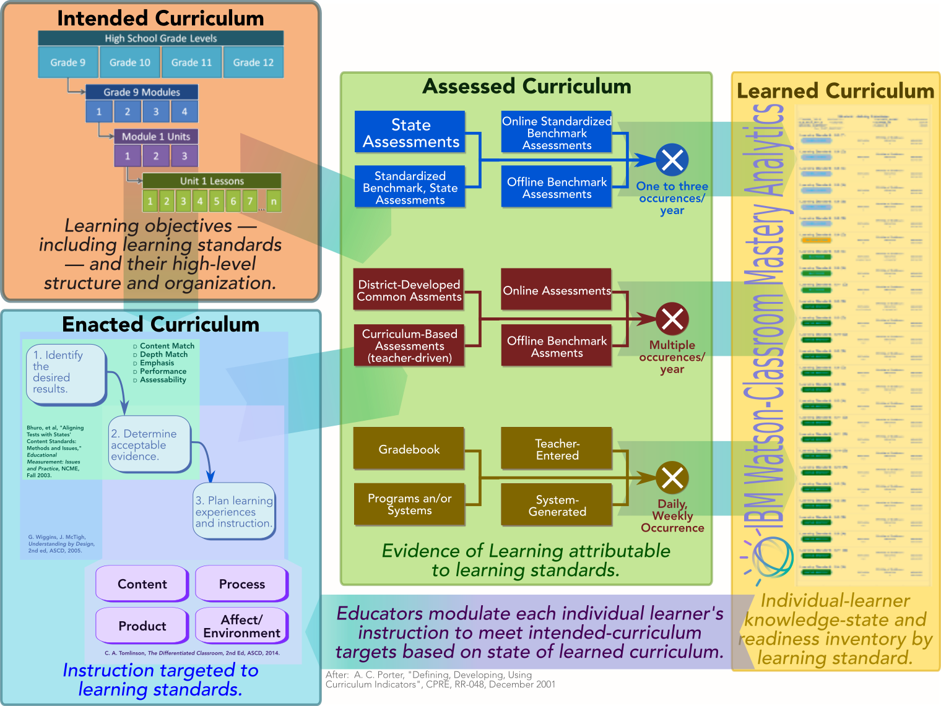
Watson-Classroom school districts derive value from the Mastery feature commensurate with the extent to which their curriculum is aligned.
Standards-aligned evidence of learning.
Policies, preferences for imputing learners’ state of knowledge based on proficiency measurements
What the Mastery algorithm produces.
Learning-standards baseline.
Learning-standards progressions.
Course blueprints/curriculum maps.
Learning-standards version migration.
Teacher units.
Course enrollment.
Course-section teaching assignments.
Instructional content aligned to intended curriculum.
Instructional guides, lesson plans, .

Slide 2
Watson-Classroom’s curriculum-alignment precision requirements exceed what adopting school districts can easily extract from peer education-technology systems.
Curriculum Component | State of Current Support |  | Gaps in Support | Consequences of Gaps | Recommended Tooling-Remediation Approach
Overall Workflow
Overall workflow | Configuration of Watson-Classroom involves collection of 2½ dozen tables. Each of these are handled in an ad hoc fashion, following processes that appear never to occur in the same way twice. | Configuration of Watson-Classroom involves collection of 2½ dozen tables. Each of these are handled in an ad hoc fashion, following processes that appear never to occur in the same way twice. | No tooling exists for standardized, repeatable Classroom-initialization workflow. | Near-catastrophic inefficiencies, including: Wasted time due to tables uploaded into sftp without notification of follow-up by IBM; Multiple versions with confusion about what is valid; Recurring touch labor associated with
Intended Curriculum
Learning-standards baseline. | Major jurisdictions’ (states) official learning-standards policies obtained via single learning-standards curator. Watson Education spends ≲1FTE in rendering official baselines Watson-consumable. | Major jurisdictions’ (states) official learning-standards policies obtained via single learning-standards curator. Watson Education spends ≲1FTE in rendering official baselines Watson-consumable. | Substantial proportion of potentially-addressable market (≳15% of recent, prospective client base) deviates from official state policies. Curator's representations inconsistent in some regards with curriculum implementations in their jurisdictions. | Writing off swath of addressable market. Current approach to to capturing “deviant” learning-standard baselines — populating csv tables — stretches, exceeds clients capabilities. | Construct web-based learning-standards authoring/editing tool by which clients document their learning-standards baselines. Develop standard easily priceable engagement model for initialization of “deviant” standards baselines.
Course-unit-learning standard alignments (aka curriculum maps, course blueprints, ….) | Curriculum-mapping tool under development. Estimated availability date August 10, 2018. | Curriculum-mapping tool under development. Estimated availability date August 10, 2018.
Learning-standards vertical articulations (aka “progressions”). | Watson Education acquired, secured usage rights for most-commonly used learning standards baselines. | Watson Education acquired, secured usage rights for most-commonly used learning standards baselines. | Watson Education’s “out-of-the-box” vertical articulations not useful for clients using “deviant” learning-standards baselines. Entire swaths of curricula (social studies, science, unassessed subjects) not addressed. | Writing off swath of addressable market. 50-75% underutilization for clients in addressable market. Current approach to to capturing “deviant” learning-standard baselines — populating csv tables — stretches, exceeds clients capabilities. | Construct web-based vertical-alignment definition tool by which client curriculum administrators can edit existing, create new learning-standard progressions.
Learning-standards version migration. | Client jurisdictions periodically update learning-standards versions. Watson Education developed a method involving ≈ 24 hours of data engineering | Client jurisdictions periodically update learning-standards versions. |  | Watson Education developed a method involving ≈ 24 hours of non-recurring data engineering effort.
“Logical” alignment of intended curriculum. |  | No support. |  | Clients may specify course blueprints, vertical articulations that contain little or no overlap. Mastery yields no estimates when these curriculum components are not aligned.

Slide 3
Watson-Classroom’s curriculum-alignment precision requirements exceed what adopting school districts can easily extract from peer education-technology systems.
Curriculum Component | State of Current Support | Gaps in Support | Consequences of Gaps | Recommended Tooling-Remediation Approach
Assessed/Learned Curriculum
Mastery-algorithm run status | Primarily managed via staging tables. Alternative offline dashboard — generated excel format via one team member’s laptop. Products embedded session-management mechanisms on the simplistic side, fail to capture complex conditions. | Incomplete view of what classes have run, what are ready to run, what has been completed. | Ready-to-run courses get missed. Difficulty explaining unexpected, anomalous conditions.
Staging-table validation. | Python-based staging table with some logic shortfalls. | Referential logic shortfall creates confusion about evidentiary coverage. | Confusion about expected completeness for Mastery. | Revise Logic.
Mastery-configuration files.

